Slide 1

Should Cash-Out
mergers be available?
April 27, 2023
Group 12
20138 COMPANY AND BUSINESS LAW (advanced course) cl. 33

Slide 2



TABLE OF CONTENTS
01
THE CONCEPT
02
POLL
03
AGENCY COSTS
04
LONG-FORM VS SHORT-FORM VS EU
05
POINTS IN FAVOUR
06
POINTS AGAINST
07
TAKEAWAYS

Slide 3


THE CONCEPT
A Cash-out merger is a merger in which some or all the minority shareholders receive, instead of shares of the surviving company, cash or non-equity securities.
Freeze-out
Transactions
Cash-out mergers are encompassed within the broader “freeze-out transactions” category.
These take place when controlling shareholders exercise a legal right to buy out the shares of the minority (Ventoruzzo, 2010).
Cash-out
mergers
Why do they exist?
Different reasons could justify these actions by the controlling shareholders, for example:
Eliminating a troublesome minority within the company;
Eliminating a minority shareholder in a wholly-owned subsidiary by the majority shareholders ;
Going private, that is revert to a private corporation through a forced purchase of X’s publicly held shares.

Slide 4




AGENCY COSTS
CONTROLLING SHAREHOLDERS
VS
MINORITY SHAREHOLDERS
DIRECTORS
VS
MINORITY SHAREHOLDERS
The majority aims to maximise the effectiveness of its investments, creating the best environment in which managers and directors can operate. Mergers by cash-out certainly could create several advantages from this point of view, but with the risk of generating injustices for the minority:
Squeezed out of the company;
Lose future share of profits;
Risk of receiving an unfair price due to the absence of bargaining power in the transaction.
(These points will be discussed later, in the pros & cons slide).
In short-form mergers, being the BoD bypassed through a tender offer directly addressed to the minority, the latter can tender at a lower price per share (the minority shareholders suffer a prisoner’s dilemma) than what could have been negotiated by the BoD.
In long-form mergers, BoD has a crucial role in negotiating the deal and can follow personal interests (e.g. empire building, higher status or income) or exclusively the ones of the controlling shareholders, at the expense of the minority.
e.g. Kahn v. Lynch (1993) the BoD of the subsidiary was threatened through a hostile tender offer.

Slide 5


Assume that you are a minority shareholder and the controlling one decides to perform a cash-out merger to your detriment.
A majority has already been obtained and the BoD has negotiated the agreement. Each share receives a price equal to market price plus a premium of 10% without a minority vote and without a request for an independent committee analysis. What do you opt for?
A. Accept the offer (the premium ensures a return on my investment)
B. Reject it and start a lawsuit (European thought: the shares are mine and nobody can take them away without my consent)
C. Propose an analysis by an independent analyst at your own expense before proceeding (no guarantee that you will gain)

Slide 6

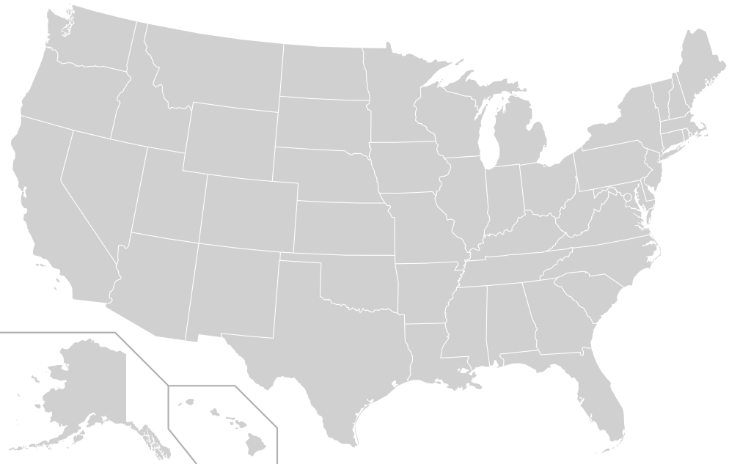



US: §253 DGCL
EU: LANDSCAPE
LONG-FORM MERGER
Cash out mergers are generally not permitted in Europe.
According to Art. 3 and 4 of the Third Directive:
In any merger SHs of the constituent must receive shares according to an exchange ratio;
Cash payments are possible without exceeding the 10% of the NV of the shares.
"One-step freeze-out"
Controlling shareholders approve a merger and pay the minority
shareholders with cash/non-equity securities in exchange of their shares.
Subject to the "Entire fairness review":
Self-dealing transactions (Weinberg v. UOP)
Burden of proof on defendants unless MoM (Majority-of-Minority) or approval by independents directors applied – then burden of proof is shifted to plaintiff.
ART. 15 (2004) – TAKEOVER DIRECTIVE
But freeze-out transactions are possible under certain circumstances.
Indeed, any shareholder acquiring at least 90% of the voting shares of a listed company through a tender offer can cash-out minorities at a fair price.
Main difference with short-form merger: target corporation can decide to merge with the parent or to maintain its independence as a wholly owned subsidiary.
Being a European directive, each Member State has adopted its own discipline regarding this issue, roughly similar to Art. 15.
SHORT-FORM MERGER
"Two-step freeze-out"
AktG (Das deutsche Aktiengesetz)
It is a voluntary tender offer on all the outstanding shares issued by the parent corporation, aimed at acquiring at least 90% of the outstanding shares, followed by a short-form, cash-out merger.
Business judgement rule applies – "Entire fairness review" doesn't:
Tender offer is voluntary;
Not self-dealing transaction.
But coercion could still be present – Pure’s three conditions
Stricter conditions than Art. 15. Controlling shareholders must hold at least 95% of the shares before proceeding with a freeze-out deal. Moreover, it is not envisaged a tender offer neither an evaluation by an independent expert.
British Scheme of Arrangement
It constitutes a more flexible procedure to reach a broad variety of outcomes (potentially also cash-out minorities). Existing case law is limited on the subject and doubts remain as to whether the procedure is the same as short-form merger in the US.

Slide 7

POINTS IN FAVOUR
COST REDUCTION
FOR MINORITY PROTECTION
LEGAL LITIGATION RISK REDUCTION
GOING PRIVATE
E.g. right to participate at the general meeting, right of information and of access to the books of the company, fiduciary duties toward minority shareholders for the BoD (e.g. self-dealing transaction).
Lawsuits, besides being financially costly, can effectively block the execution of structural changes of the corporation and make it lose corporate opportunities (Krebs, 2012).
For listed companies, could be more economically advantageous to go private. Different reasons could lead to that decision, like perception of a wrong market value, reduction of compliance costs with institutions (Krebs, 2012).
REDUCED
SEPARATION
ESCAPE ROOM
MITIGATE
FREE-RIDERS
Diminish agency costs, avoiding minority to (or threatening to) jeopardize the majority’s owner plans, reducing the risk of obstructionism. Moreover, having full control can make the “survivor shareholder” being more motivated in pursuing the business (Ventoruzzo, 2010).
Giving the opportunity to easily delist companies, assuming that a cash-out merger is the most suitable instrument to achieve the goal, could incentivize more companies to list because they know that in the future, they could have the opportunity to turn back.
Minority shareholders may be reluctant to sell their shares especially following an assumption that post-merger value would be higher. In cash-out mergers they are indifferent in tendering or retaining and there will exist an equilibrium in which the price would be lower than the post takeover-value (Dalkir, 2018).

Slide 8

POINTS AGAINST
Some possible points against cash-out mergers are related to the conditions at which freeze-out is settled by controlling shareholders:
By deciding the timing of the transaction, majority shareholders can leverage the capital market volatility when shares are potentially undervalued, shifting the entire costs of the transaction onto the minority ones.
For long-term mergers, being self-dealing transactions (Weinberg v. UOP-1983) the “entire fairness standard of review” (fair dealing and fair price) applies. It will be in controlling shareholders’ interest to implement some minority protections, such as the majority of minority vote (Rosenblatt v. Getty Oil-1985) or the approval by a truly independent committee (Kahn v. Lynch-1993)
There’s information asymmetry not only between controlling and minority shareholders but also between the majority shareholders and the court, making it difficult to correctly estimate the fairness of the freeze-out price (Kahan and Bebchuk,1999).
It is possible to partially solve this problem through the role of a truly independent committee that can evaluate the fairness of the price (granting its full independence and providing it with the full disclosure needed).
The controlling shareholders are not incentivized to introduce both a MoM and an independent committee in the long-form merger or voluntarily introduce it in the short-term merger (not required by the three “In re Pure Resources case-2002” conditions).
To overcome this problem, it could be possible to require as mandatory to require both MoM and independent committee for the long-form mergers and to add them as a fourth condition for the short-form merger.
An efficient market achieves efficient results even without government intervention. If this is the case, provisions to adequately protect minorities (if that is considered efficient) will be added to the articles of incorporation by the firm and no government regulation of takeovers will be necessary. (Panunzi, 2003)
However, the assumption that the market is efficient is questionable due to the presence of certain shortcomings such as the prisoner's dilemma and opportunistic minority behaviour (free-rider problem). In addition, the large number of disputes that have occurred over the years underlines a pressing need for government regulation.

Slide 9




TAKEAWAYS & RECOMMENDATIONS
We are in favour of cash-out mergers only if thoroughly regulated: indeed, the advantages of this technique can outweigh the disadvantages only if clear and effective protections are introduced to reduce the agency cost between minority and majority shareholders.
The US model, and in particular the well-established Delaware jurisprudence, is a perfect example of how, by providing sufficient protection to minority shareholders, sufficient flexibility can be left to controlling ones to pursue the efficiency of their investment through cash-out mergers.
Furthermore, empirical evidence underlines that in order to reduce the problem of information asymmetry, the introduction of both mandatory MoM and approval by an independent committee in long-term mergers may be a plausible way forward.
INDEPENDENT COMMITTEE’S
APPROVAL
MAJORITY-OF-MINORITY

Slide 10
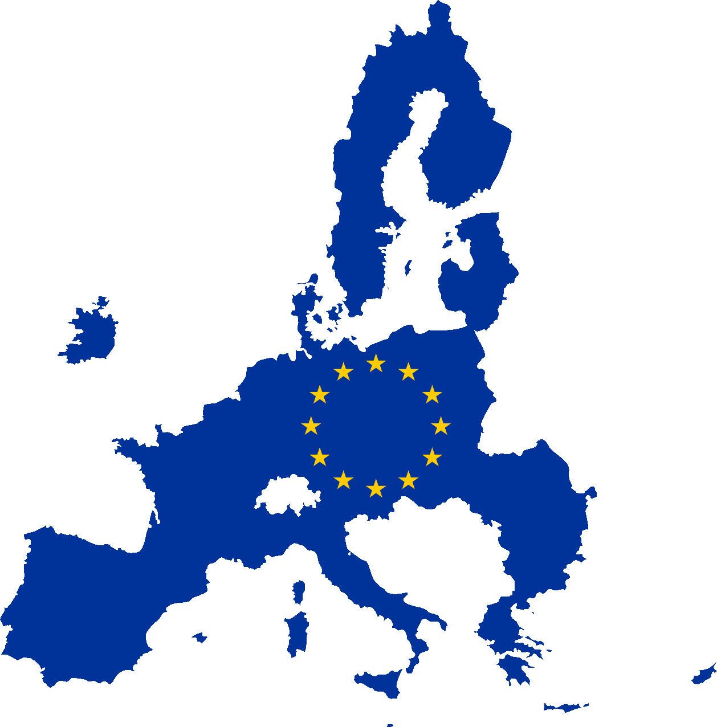

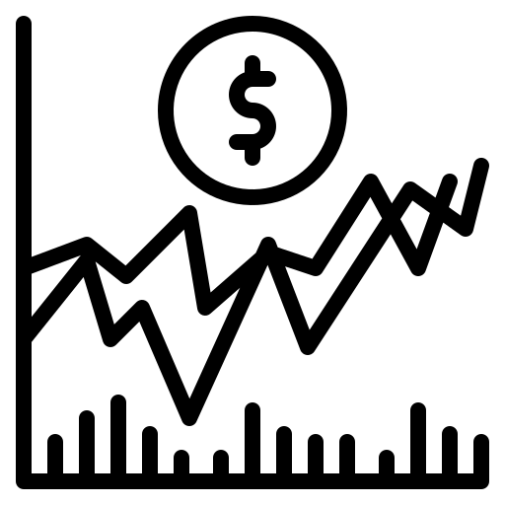
TAKEAWAYS & RECOMMENDATIONS
It is also interesting to examine the European case where, theoretically, a cash-out merger is not allowed according to the logic that shareholders' participation rights cannot be taken away without their consent. Yet this is debatable, being the acceptance of the tender offer in the short-form merger left to the shareholder's will and doing so, the element of coercion could be strongly mitigated.
The risk of adopting more conservative rules is to become less able to compete in attracting foreign corporations (a higher freeze-out threshold results in higher costs for the controlling shareholder). We thus suggest the EU to pursue a stronger harmonisation process, following the example of the US short-form merger.
Our last proposal is introducing a class of redeemable shares which provides higher returns but with the possibility for the controlling shareholders to redeem them whenever they want. To avoid any opportunistic behaviour a fair price has to be defined. A possible solution could be setting the share price as the average of the last X years. In addition, if the current market price is higher than this average, a premium price has to be granted. This is coherent with the idea that in the US minority investors have mainly a financial interest (Ventoruzzo et al, 2017), but likely still distant from the EU current perspective.

Slide 11

Our team
Cl 33.
Group 12
Belvedere Niccolò - 3090720
Brambilla Andrea - 3228575
Garaffa Nicolò - 3096048
Ilaghi Hosseini Alessio - 3220627
Wu Zhenzhen - 3204201

